Slide 1


Object-oriented Software Engineering
Caitriona Nic Lughadha

Slide 2
What we are going to do today?
INTROCCTION
Module Schedule: Learning Outcomes, Workload
Assessment
Reading Material
Module Overview
How can we help each other?
WHAT WE ARE LEARNING?

Slide 3
IntroDuing Myself
Caitriona Nic Lughadha
BSc Computer Science, MSc in Software Development
30+ years of experience in Software Industry
Software Developer, Technical Trainer, Project Manager, Release Manager, People Manager, Quality Manager
Joined NCI Associate Faculty January 2024

Slide 4
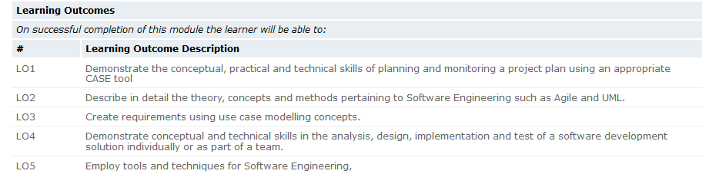
LEARNING OUTCOMES OF H8OOS - OOSE
http://courses.ncirl.ie/index.cfm/page/module/moduleId/67418

Slide 5
MODULE TARGET WORKLOAD HOURS
LECTURE – 24 HOURS – 2 HOURS PER WEEK Monday 9am – 11am
TUTORIAL/LAB - HOURS – 1 HOUR EVERY FRIDAY 2pm - 3pm
INDEPENDENT LEARNING – AVERAGE HOURS PER WEEK 7.42
READING WEEK 26th October – 1st November

Slide 6
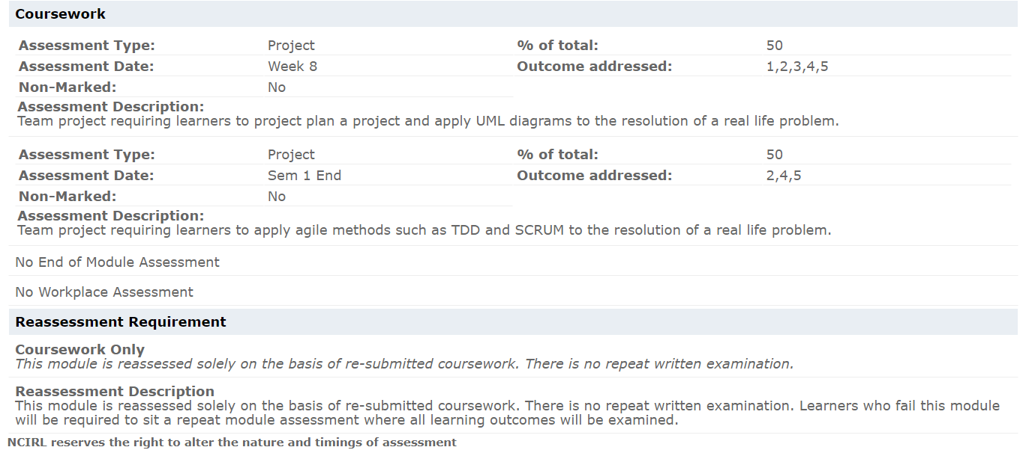
Assessments

Slide 7
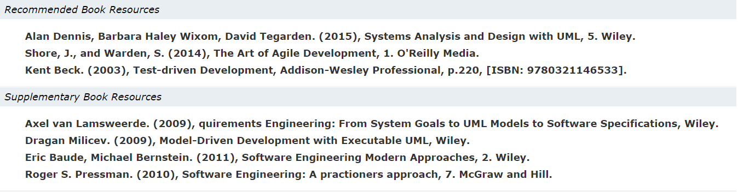
Reading material - books

Slide 8
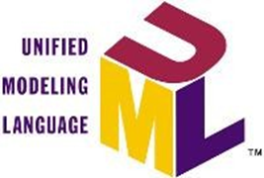
LINKS
https://developer.ibm.com/articles/an-introduction-to-uml/

Slide 9
FURTHER RESOURCES
MOODLE
LECTURE SLIDES.
LECTURES WILL CONTAIN LINK TO ONLINE RESOURCES AS WELL.
https://moodle2024.ncirl.ie/course/section.php?id=27113

Slide 10
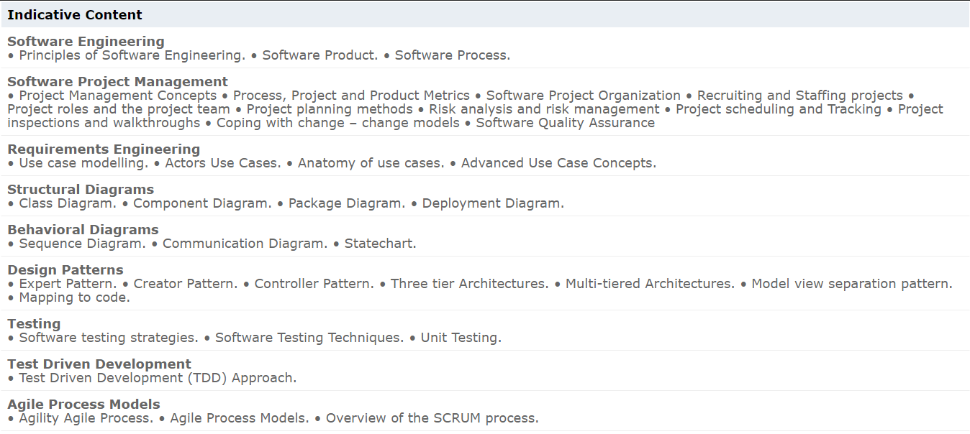
SYLLABUS
http://courses.ncirl.ie/index.cfm/page/module/moduleId/67418

Slide 11
HOW CAN WE HELP EACH OTHER?
Ask me questions during lectures especially if you don’t understand something
Join in discussion in the class
Answer questions when asked
Give related examples when asked,
Share your thoughts or experience on the topic
Share extra knowledge you might have on the topic

Slide 12
WHAT ARE WE STUDYING ?
Object Oriented Software Engineering
1. Object Oriented ?
2. Software ?
3. Engineering ?

Slide 13
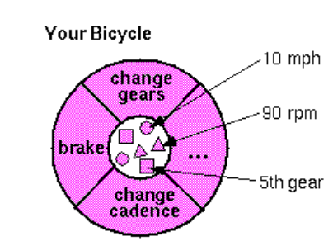
OBJECT ORIENTED
objects are key to understanding object-oriented technology
ANY REAL WORLD EXAMPLE ?
STATE
2. BEHAVIOUR
Notes:
Everything that the software object knows (state) and can do (behavior) is expressed by the variables and methods within that object. A software object that modelled your real-world bicycle would have variables that indicated the bicycle's current state: its speed is 10 mph, its pedal cadence is 90 rpm, and its current gear is the 5th gear. These variables and methods are formally known as instance variables and instance methods to distinguish them from class variables and class methods. The above figure illustrates a bicycle modeled as a software object.

Slide 14

SOFTWARE
Executable code, which serves some computational purpose.
A collection of executable programming code, associated libraries and documentation.
Software made for specific requirement(s) is called software product.
Notes:
Software products may be developed for a particular customer or may be developed for a general market.
Software products may be
–Generic - developed to be sold to a range of different
customers e.g. PC software such as Excel or Word.
–Bespoke (custom) - developed for a single customer according to their specification.
New software can be created by
◦developing new programs,
◦configuring generic software systems or
◦reusing existing software.

Slide 15
WHAT IS ENGINEERING ?
Solving problems, developing products using well-defined, scientific principles and methods.
https://www.youtube.com/watch?v=bipTWWHya8A&t=17s
But why do we need Software Engineering?

Slide 16
Why do we need software engineering?

Slide 17
Software failures
Any recent examples you can think of?
https://www.testdevlab.com/blog/10-biggest-software-bugs-and-tech-fails-of-2021
https://edition.cnn.com/2024/07/19/tech/tech-outage-crowdstrike-software/index.html
https://www.reuters.com/business/media-telecom/oasis-fans-left-frustrated-technical-problems-hit-ticket-sales-2024-08-31/

Slide 18
What causes software failures?

Slide 19
What WE LEARN from those failures ?
Incorrect or Incomplete Software
Developers did not anticipate seldom-occurring situations
user actively misusing the system (taping down a button, use of bots, hacking
Inadequate platform
Unexpected heavy traffic
Management failures
On-time delivery of an incorrect system that does not meet the requirements
Unnecessary complexity for users or maintenance

Slide 20
What is ‘good’ software ?

Slide 21
What are the attributes of good software ?
Deliver the required functionality and performance to the user
Maintainability - Software must evolve to meet changing needs
Acceptability -Software must accepted by the users for which it was designed. This means it must be understandable, usable and compatible with other systems.
Dependability - Software must be trustworthy
Efficiency - Software should not make wasteful use of system resources
Notes:
Maintainability - Software must evolve to meet changing needs
Acceptability –Software must accepted by the users for which it was designed. This means it must be understandable, usable and compatible with other systems.
Dependability –Software must be trustworthy
Efficiency –Software should not make wasteful use of system resources;

Slide 22
What is software engineering ?
It is a discipline that is concerned with all aspects of software production.
Software engineers should:
adopt a systematic and organized approach to their work and
use appropriate tools and techniques depending on
the problem to be solved
the development constraints and
the resources available.

Slide 23
Where is the problem ?
Complexity
Change
Useful software systems are complex. To remain useful, they need to evolve with the end users’ needs and the target environment.

Slide 24
How Is software engineering defined ?
A “systematic approach to the analysis, design, assessment, implementation, test, maintenance and reengineering of software, that is, the application of engineering to software”
Laplante, Phillip, 2007
Download and Read more on Software Engineering. Software Engineering Body of Knowledge (SEBOK). https://www.computer.org/education/bodies-of-knowledge/software-engineering/v3
Notes:
Note: The Guide to the Software Engineering Body of Knowledge (SWEBOK) describes 15 areas that are fundamental to the profession.1 The knowledge areas should not surprise any practicing software engineer. They span software requirements, design, construction, testing, maintenance, configuration management, software engineering management, software engineering processes, models and methods (including formal and agile methods), software quality, professional practices, software-engineering economics, computing foundations, mathematical foundations, and engineering foundations.

Slide 25
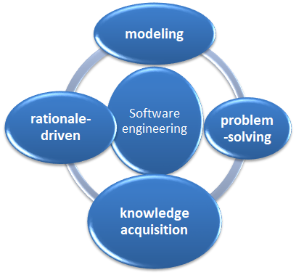
Software Engineering Involves

Slide 26

Modeling
Software engineering is a modeling activity. Software engineers deal with complexity through modeling, by focusing at any one time on only the relevant details and ignoring everything else.

Slide 27
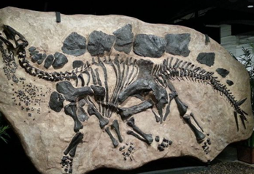
Modeling in real world
For example: Fossil biologists unearth a few bones and teeth preserved from some dinosaur that no one has ever seen. From the bone fragments, they reconstruct a model of the animal, following rules of anatomy. The more bones they find, the clearer their idea of how the pieces fit together and the higher the confidence that their model matches the original dinosaur. If they find sufficient number of bones, teeth, and claws, they can almost be sure that their model reflects reality accurately, and they can guess the missing parts.

Slide 28
SOFTWARe engineer challenges
First, software engineers need to understand the environment in which the system is to operate.
For Examples:
For a train traffic control system, software engineers need to know train signalling procedures.
For a stock trading system, software engineers need to know trading rules.

Slide 29

Knowledge acquisition
It is a knowledge acquiring activity. In modeling the application and solution domain, software engineers need to collect data, organize it into information, and formalize it into knowledge. Knowledge acquisition is nonlinear, as a single piece of data can invalidate the model completely.

Slide 30
Rationale driven
It is a rationale-driven activity.When acquiring knowledge and making decisions about the system or its application domain, software engineers also need to capture the context in which decisions were made and the rationale behind those decisions.
Rationale information, represented as a set of issue models, enables software engineers to understand the implication of a proposed change when revisiting a decision.

Slide 31
Modeling software on basis of knowledge acquisition and rationale driven
Software engineers need to understand the systems they could build, to evaluate different solutions and trade-offs.
Most systems are too complex to be understood by any one person and are expensive to build.
They need to build a model of the solution domain.

Slide 32

Problem solving
Clearly understanding and/or defining the problem.
Breaking down large problems into smaller problems.
Solving the problem at an abstract level first.
Using notes and pseudo-code.

Slide 33
Caution: you can’t use Wikipedia for QUOTE.
... But this is worth a look
http://en.wikipedia.org/wiki/Software_engineering
Just never quote from it!!
Software Engineering (SE) is a profession dedicated to designing, implementing, and modifying software so that it is
of high quality,
affordable,
maintainable,
fast to build.

Slide 34
What is software process ?
Specification - what the system should do and its development constraints
Development - production of the software system
Validation - testing that the software is what the customer wants
Evolution - changing the software in response to changing demands.

Slide 35
Software process model
A simplified representation of a software process, presented from a specific perspective.
Examples of process perspectives are
Workflow perspective - sequence of activities;
Data-flow perspective - information flow;
Role/action perspective - who does what.

Slide 36
Some process models….
Waterfall
Iterative development
Component-based software engineering
Prototyping

Slide 37
What is a structured approach?
Imagine an unstructured approach to
Making a cup of coffee
Building a house

Slide 38
Structured approach
Phased approach
Modelling
Modularization
Decomposition
Iteration
Documentation
Parallel Activities
Automation of the System Development Process

Slide 39
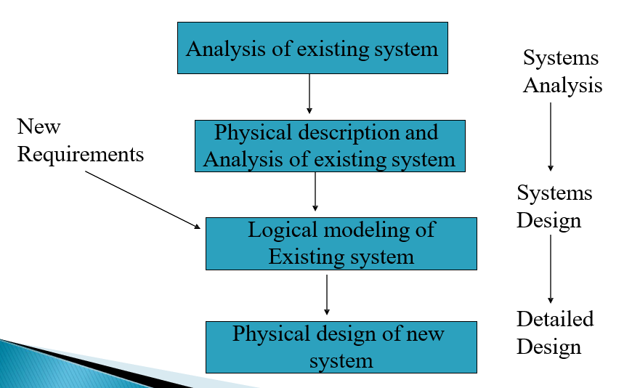
Overview of structured approach

Slide 40
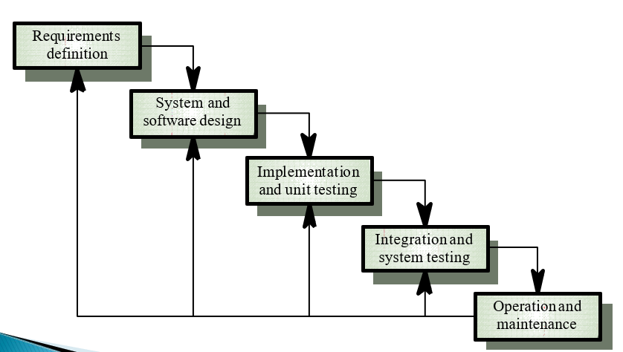
Waterfall model

Slide 41
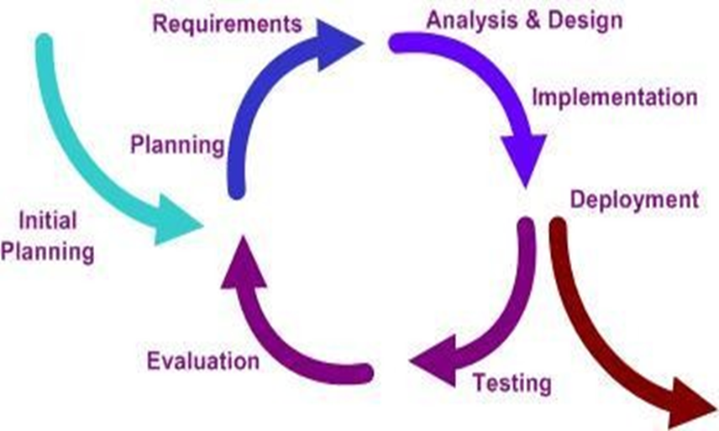
Iterative method

Slide 42
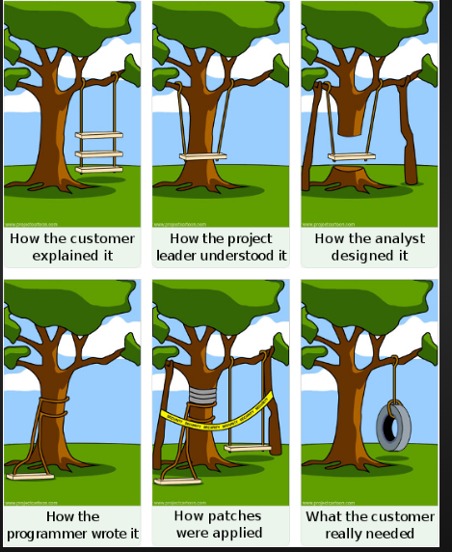
The trouble with waterfall…
https://pcreux.github.io/2009/07/10/agile-development-in-a-nutshell/

Slide 43
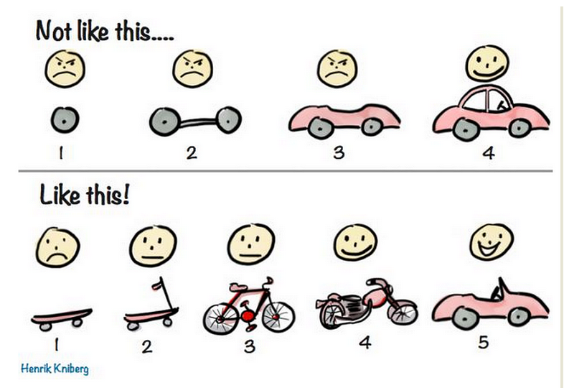
Doing iterative right….
https://www.scrumalliance.org/community/profile/hkniberg

Slide 44
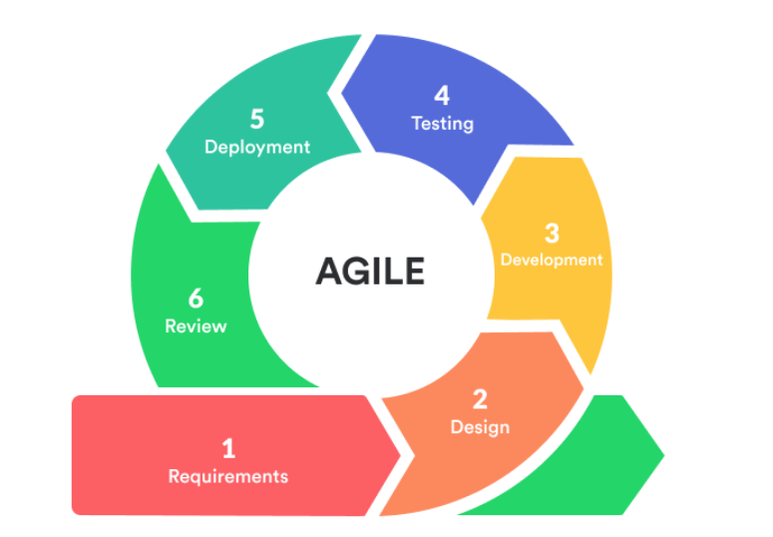
Software Lifecycle
Specification
Development
Validation
Delivery
Evolution
Requirements gathering
Architecture definition
Design
Code
Test
Deploy
Release
Maintain
Update
Enhance
Agile ( iterative)
approach
Requirements and Feedback
Object Oriented approach
Use Cases
Design
Code and Unit Test
Evolution
User modelling
Maintain
Update
Enhance
Use Cases
Behaviour modelling
Abstraction
Inheritance
Polymorphism
Encapsulation
Class Identification
Test
Reuse
Java
Other OO languages
Test Driven Development
Use Acceptance Test
Prototyping
Unit tests
Automated Regression
Tests
Functional Tests
Project Lifecycle
Define
Plan
Scope
Outcome
Execute
Close
Resources
Timeline
Processes
Track
Monitor
Adjust
Manage
Evaluate
Risks

Slide 45
Object Oriented

Slide 46
Object-oriented approach
It combine the problem and solution domain modelling activities into one. The problem domain is first modeled as a set of objects and relationships.
This model is then used by the system to represent the real-world concepts it manipulates.
A train traffic control system includes train objects representing the trains it monitors.
A stock trading system includes transaction objects representing the buying and selling of commodities.

Slide 47
Object-Oriented Software Engineering (OOSE)
It is a disciplined method for the industrial development of software. It is based on use case driven design, an approach to object-oriented analysis and design that centres on understanding the ways in which a system is actually used.
By organizing the analysis and design models around sequences of user interaction and actual usage scenarios, the methodology produces systems that are both more useable and more robust, adapting more smoothly to changing usage.

Slide 48
OBJECT ORIENTED
objects are key to understanding object-oriented technology
ANY REAL WORLD EXAMPLE ?
STATE
2. BEHAVIOUR
Notes:
Everything that the software object knows (state) and can do (behavior) is expressed by the variables and methods within that object. A software object that modelled your real-world bicycle would have variables that indicated the bicycle's current state: its speed is 10 mph, its pedal cadence is 90 rpm, and its current gear is the 5th gear. These variables and methods are formally known as instance variables and instance methods to distinguish them from class variables and class methods. The above figure illustrates a bicycle modeled as a software object.

Slide 49
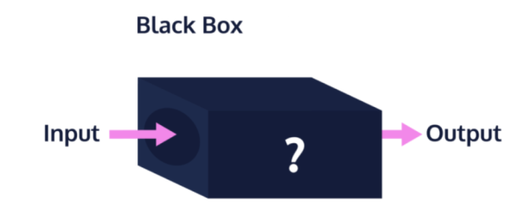
Object oriented software
It is all about objects. An object is a "black box" which receives and sends messages.
A black box contains code (sequences of computer instructions) and data (information which the instructions operates on).
Traditionally, code and data have been kept apart.

Slide 50
OO concept : abstraction
Abstraction is one of the fundamental concepts of software engineering. It is all about hiding complexity in building various parts of your application.
For Example: Consider a real-world analogy. Let’s say you want to ride a motor bike. All you need to start the motor bike is to put the key on, push the start button, and use the accelerator. While riding, you may need to use the brake as well.
You are not really concerned about how the engine, accelerator and brake are working during the ride. All that is abstract to you, and you are not concerned with it (unless you are mechanic).

Slide 51
Abstraction continued
Abstraction is a concept that reduces the behavior of an object to the lowest common denominator.
Abstraction helps us deal with complexity
Used to build models
Objects and Classes are main abstraction mechanisms in the Object-Oriented Approach

Slide 52
Object Oriented Concept - Inheritance
Inheritance means that methods and/or attributes defined in an object class can be inherited or reused by another object class.
Generalization / specialization is a technique wherein the attributes and behaviours which are common to several types of object classes are grouped into their own class, called a supertype. The attributes and methods of the supertype object class are then inherited by those object classes.
A class subtype is an object class which inherits some common attributes form a class supertype and then adds other attributes that are unique to an instance of the subtype.

Slide 53
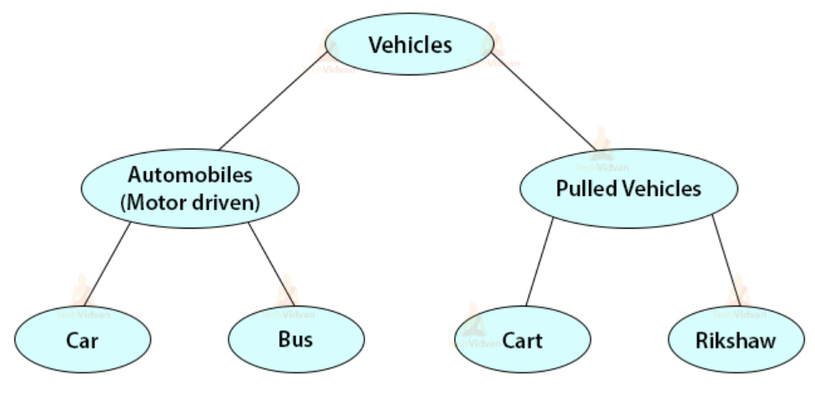
Example:

Slide 54
OO principles: Encapsulation
Encapsulation forms a self-contained object by bundling the data and functions it requires to work, exposes an interface where-by other objects can access and use it, and restricts access to certain inside details.
Encapsulation – making a sort of capsule. A capsule contains something inside you can access from outside and some which of you cannot.
First bundle data and behaviors that manipulate those values together into a self-contained object. You can expose certain but not all.

Slide 55
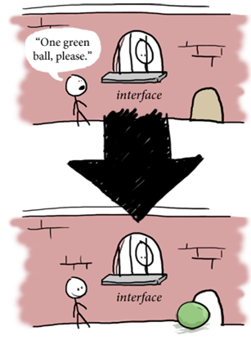

Slide 56
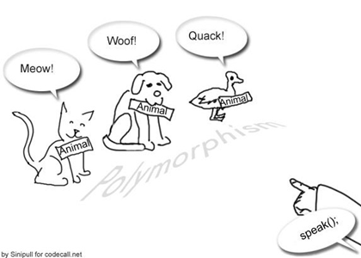
OO principles: Polymorphism
It means “many forms”. Applied to object-oriented techniques it means that the same named behavior may be completed differently for different objects/classes.

Slide 57
Example
As an example, consider two objects “window” and “door”. Both objects have a common behavior that they may perform - close.
But how a door object carries out that behavior may differ substantially from the way in which a window carries out that behavior.
Inheritance and Polymorphism are effective techniques for dealing with software complexity.
LOOK INTO THIS VIDEO FOR MORE INSIGHT TO OO Principles here.

Slide 58
Unified Modelling Language (UML)
A non-proprietary, third generation modelling language. The Unified Modelling Language is an open method used to specify, visualize, construct and document the artefacts of an object- oriented software-intensive system under development.
The UML represents a compilation of "best engineering practices" which have proven successful in modelling large, complex systems.
(Free OnLine Dictionary of Computing *
http://foldoc.org/UML)
* useful for many other definitions also

Slide 59
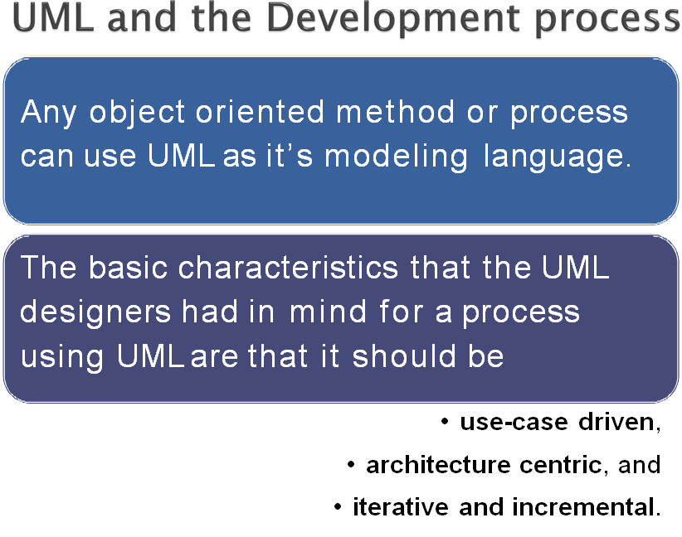

Slide 60
Use case driven
In UML use cases capture the functional requirements of the system.
In use-case driven methodologies they drive the development in all phases after the requirements analysis.
During analysis, they are used to capture the required functionality and to validate this functionality with the customer.
During design and implementation,
Use cases must be realized in the construction.
During testing, the use cases verify the system; they become the test cases.

Slide 61
Architecture centric
This means that you consider a well-defined, basic system architecture is important, and that this architecture should be established early in the process.
The architecture works as a map of the system that defines:
The different parts of the system, their relationships and interactions and their communication mechanisms.
It is especially important to define a system architecture that can be modified, that can be understood intuitively, and that enables reuse.

Slide 62
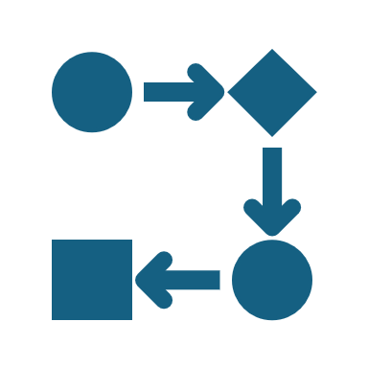
Iterative
The phases of the development process are iterative.
This is important as building models with UML is best done as a number of smaller iterations.
Each iteration adds some new information or detail. The iteration is evaluated, either on paper or in a working prototype, and used to produce input for the next iteration.
A process that uses iterations provides continuous feedback that improves the process itself as well as the final product.

Slide 63
Incremental
An increment is a step in the evolution of the system,
When developing iteratively and incrementally, the development is based on a number of versions.
Each version should add new functionality or attributes to the project and the version’s contents should be planned.
Each version is delivered and evaluated by it’s technical, economical and process merits.
sometimes called a version of the system.

Slide 64
The big picture

Slide 65
Software Lifecycle
Specification
Development
Validation
Delivery
Evolution
Requirements gathering
Architecture definition
Design
Code
Test
Deploy
Release
Maintain
Update
Enhance
Agile ( iterative)
approach
Requirements and Feedback
Object Oriented approach
Use Cases
Design
Code and Unit Test
Evolution
User modelling
Maintain
Update
Enhance
Use Cases
Behaviour modelling
Abstraction
Inheritance
Polymorphism
Encapsulation
Class Identification
Test
Reuse
Java
Other OO languages
UML Diagrams
UML Diagrams
Test Driven Development
Use Acceptance Test
Prototyping
Unit tests
Automated Regression
Tests
Functional Tests
Project Lifecycle
Define
Plan
Scope
Outcome
Execute
Close
Resources
Timeline
Processes
Track
Monitor
Adjust
Manage
Evaluate
Risks

Slide 66
Object Oriented Design

Slide 67
How is an object defined in SE ?
An Object is a concept, abstraction, or thing with sharp boundaries and meaning for an application.
An Object is an entity (physical or conceptual) which has attributes and operations that can affect (query or change) those attributes.

Slide 68
An object is something that has:
STATE
BEHAVIOUR
IDENTITY

Slide 69
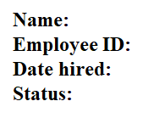
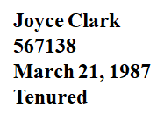
Object has state
State of an object is one of the possible conditions in which an object may exist.
It normally changes over time:
is usually implemented by a set of properties (called attributes)
with the values of the properties, plus the links the object may have with other objects
Example: EMPLOYEE

Slide 70
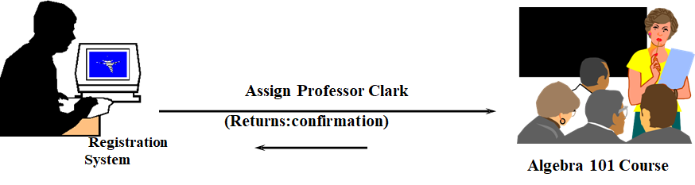
Object has behavior
Determines:
how an object acts and reacts
defines how an object reacts to requests from other objects
The visible behavior of an object is modeled by the set of messages it can respond to (the operations the object can perform)

Slide 71
Object has identity
Each object has a unique identity, even if its state is identical to that of another object

Slide 72
What are classes?
A class is a description of a group of objects with common properties (attributes), common behavior (operations), common relationships to other objects (associations and aggregations), and common semantics
An object is an instance of a class
It emphasizes relevant characteristics and suppresses other characteristics

Slide 73
Relationship between classes and objects
A class is an abstract definition of an object
It defines the structure and behavior of each object in the class
It serves as a template for creating objects
Objects may be grouped into classes
http://www.youtube.com/watch?v=tWIe9E4SWQo

Slide 74
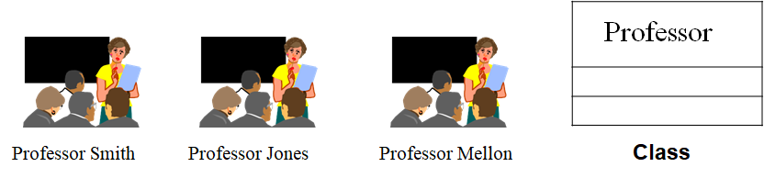
OBJECT

Slide 75
Attribute
An attribute is a data definition held by instances of a class
Attributes do not have behavior - they are not objects
Attribute names are simple nouns or noun phrases
Each attribute should have a clear, concise definition

Slide 76
Operation
A class embodies a set of responsibilities which define the behavior of the objects in the class
The responsibilities of a class are carried out by its operations
This is not necessarily a one-to-one mapping
Product class responsibility -- supply price Operations for this responsibility
Look up information from a database
Calculate the price
An operation is a service that can be requested from an object to effect behavior

Slide 77
Need for relationships
All systems encompass many classes and objects
Objects contribute to the behavior of a system by collaborating with one another
Collaboration is accomplished through relationships
There are two important types of relationships during analysis
◦Association
◦Aggregation

Slide 78
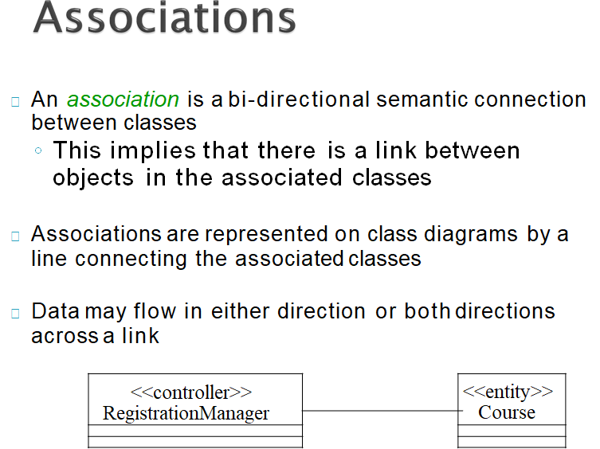

Slide 79
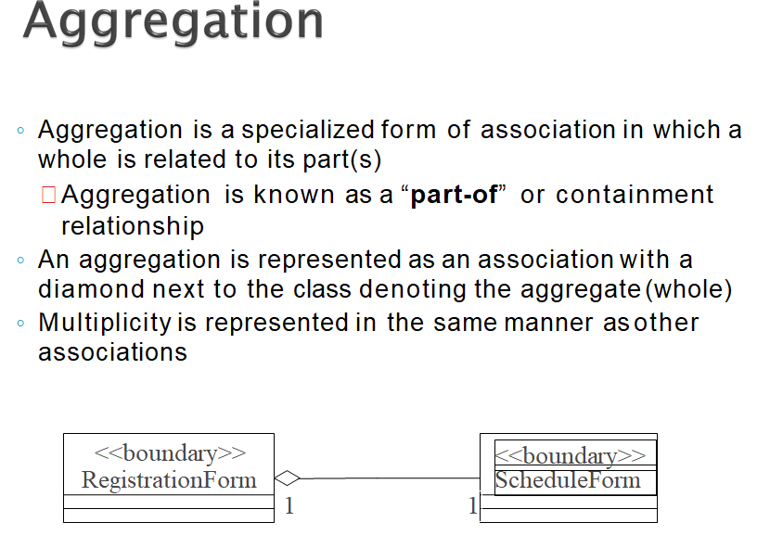

Slide 80
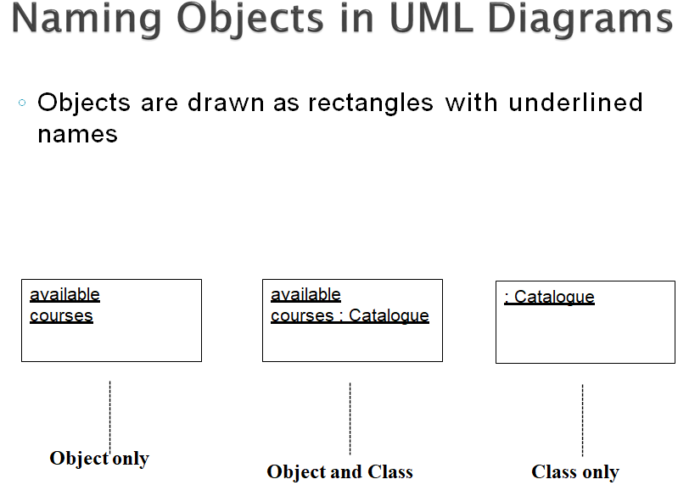

Slide 81
Summary
Have a basic understanding of OO principles such as Inheritance, Polymorphism, Encapsulation, Abstraction, (IPEA).
Have a basic understanding of the Object and Class concepts.

Slide 82
More reading
4 major principles of Object-Oriented Programming
E-Tutorials: Object-oriented software engineering (mostly focused on OOSE & games)
UML 2.0 Pocket Reference
UML 2.0 in a Nutshell

Slide 83

Q & A

